Slide 1
Senior Exit Interview
By: Angel Sanchez

Slide 2
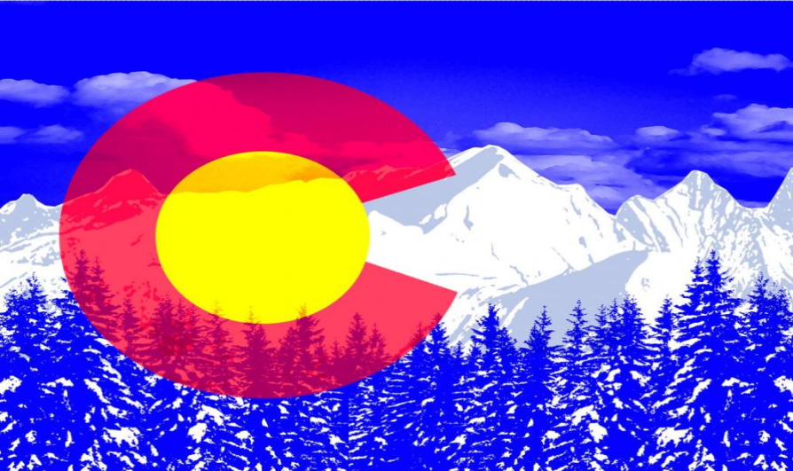
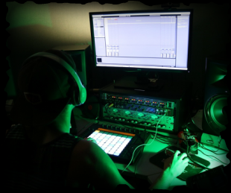
About Me
I was born in Denver, Colorado
Moved to California in 2003
I am a dancer and a DJ
Second oldest of my brothers and sisters

Slide 3
High School Experiences
Senior sun rise
Danced in the quad
Donated blood for the first time
Part of ASB leadership

Slide 4
After High School
Attend Communiuty College of Aurora
Major in Music
Get Associates Degree
Make a living as DJ

Slide 5
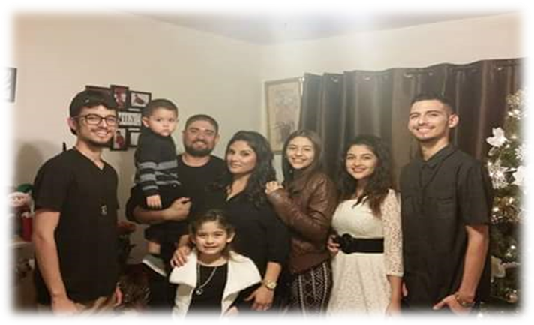
Family
Im from a family of 8
Im a twin younger by 3 minutes
3 sisters and 2 brothers

Slide 6
Questions?

